Slide 1

Customer success
Monthly support report
Lazar Milicevic
Key metrics, achievements, roadmap & next steps
August 2025

Slide 2
Agenda
1
Part I: Abstra support key metrics
2
Part II: Achievements & roadmap
3
Part III: Roadmap items
deep dive
4
Part IV: Product Insights
5
Part V: Next steps

Slide 3
Executive Summary
Customer success: Monthly Support Report - August 2025
Metrics summary:
➤ 64 tickets handled in August (+3.2% vs July), confirming stable workload and consistent triage.
➤ First response time averaged 21 minutes (–32%), a clear improvement and far below SLA.
➤ Average resolution time rose to 18.3 hrs (+1308%), impacted by a few complex cases but still resolved within SLA.
➤ CSAT at 90% (–4.7%), showing strong user satisfaction despite increased case complexity.
➤ Blocking issues remained low and fully managed within SLA.
Zendesk & Process Improvements
➤ Automated Zendesk → Slack notifications for Data Content group, cutting reaction time and manual overhead.
➤ Initiated new Pending → Open trigger, addressing a critical gap in ticket follow-ups.
➤ Deprecated manual signup approval & legacy Python script, completing full automation of signup flows.
➤ Delivered FullStory → PostHog export, with custom Python transformation script, validated test import, and S3 pipeline setup.
➤ Segmented K-Pro vs K-Navigator users in PostHog by specific tag delivered from the frontend team, preparing tier-specific dashboards with new KPIs.
TL;DR - In August, we moved from stabilizing signup flows to full automation, advanced analytics, and scalable reporting. Critical gaps were closed in Zendesk triage, PostHog dashboards were operationalized, and Cognito backfill is now set to make PostHog the definitive analytics source going forward.
Owkin K
➤ Signup and access fully automated, ensuring faster onboarding and consistent tracking across Cognito + Zendesk.
➤ Established PostHog as the single source of truth, replacing fragmented FullStory/SurveySparrow setup.
➤ Laid the foundation for Q3 scaling: production backfill from Cognito, tier-based KPI dashboards, and advanced SLA automation.

Slide 4

Agenda
1
Part I: Abstra support key metrics
2
Part II: Achievements & roadmap
3
Part III: Roadmap items
deep dive
4
Part IV: Product Insights
5
Part V: Next steps

Slide 5
Abstra at a glance - Fullstory Metrics
Customer success: Monthly Support Report - August 2025
A general overview of numerical metrics and feature adoption compared with previous month
General Metrics
Catalog Metrics
Slide Viewer Metrics
Other Metrics
Active Users
124
-35.1%
Dataset Search
605
-38.6%
Users
47
-27.7%
Target Directory Users
8
-33.3%
New Users
6
0.0%
Dataset Views
2634
-31.5%
Sessions
323
-23.3%
Average session
per user
23
-3.3%
Abstra
Documentation
20
+10%

Slide 6
Key metrics overview
Customer success: Monthly Support Report - August 2025
July
August
Change
General monthly key metrics
Tickets Received
62
64
+5.27%
August showed stable ticket volume with a slight increase compared to July. Thanks to improved processes and better routing, first response time was further reduced and remained well below SLA thresholds.
The average full resolution time increased significantly due to a small number of complex cases that extended the overall average.
Despite this, all key metrics remained within SLA limits, confirming the consistency and robustness of our support workflows.
📥 64 tickets received – a +3.23% increase vs. July, demonstrating stable system behavior and consistent filtering via improved Zendesk forms.
⚙️ 78.1% solved rate – an improvement of +5.27% compared to July, driven by stronger coordination and optimized team workflows.
⏱️ 21 min average first response time – a -32.26% decrease from July, remaining far below the 2h SLA target and highlighting faster agent engagement.
\
🛠️ 18.3 hrs average full resolution time – a +1307.69% increase vs. July, caused by a few complex cases that extended the cycle, while overall SLA compliance was maintained.
🌟 90% CSAT – a slight -4.66% drop compared to July, but still reflecting strong user satisfaction and positive support sentiment.
Solved/Received
74.19%
78.1%
+5.27%
Average First Response Time (Bus. hrs.)
31 min
21 min
-32.26%
Average Full Resolution Time (Bus. hrs.)
1.3 hrs
18.3 hrs
+1307.69%
% Satisfied CSAT
94.4%
90%
−4.66%
*Times are in business hours.
Key Observations:
✔️ Ticket volume remained stable, with only a slight month-over-month increase, supported by structured Zendesk forms and refined pre-filtering mechanisms that ensured consistent workload across request types.
✔️ Average first response time dropped significantly to 21 minutes, ensuring proactive agent engagement and consistent SLA compliance (<2h).
✔️ Average resolution time increased due to a small number of complex cases, but overall SLA compliance was maintained, confirming robustness of workflows.
✔️ User satisfaction (CSAT 90%) remains high, despite a slight decline vs. July, reflecting positive user sentiment and confidence in support quality.

Slide 7
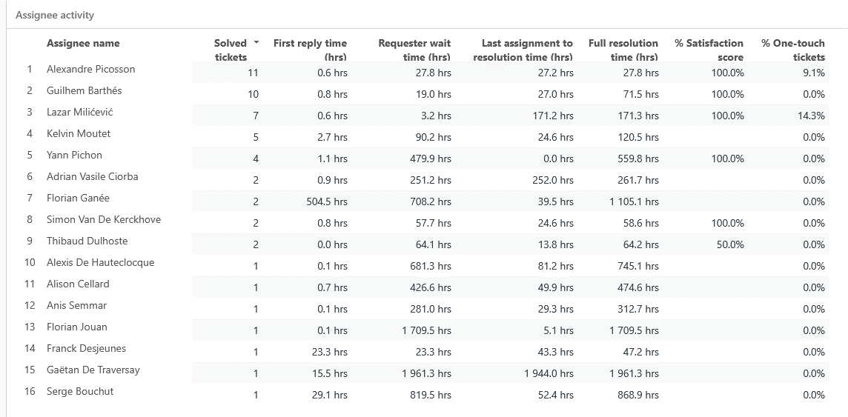
Monthly Ticket Counts & Average Resolution Times
Customer success: Monthly Support Report - August 2025
Compared with previous 3 months
2025
Tickets Received
Avg. Full Resolution Time
May
113
2.2 hrs
June
83
1.1 hrs
July
62
1.3 hrs
August
64
18.3 hrs
*Times are in business hours.
July Summary
✔️ 64 tickets – slight increase of +3.23%, confirming stable system behavior with consistent pre-filtering.
✔️ 21 min FRT – significant improvement (-32.26%) vs. July, remaining far below the 2h SLA target.
✔️ 18.3 hrs resolution – sharp increase (+1307.7%) due to a few complex cases, though SLA compliance (24h) was maintained.
✔️ 90% CSAT – small decline (-4.66%) but still a strong indicator of positive user sentiment.Note: Metrics exclude API-based tickets.
Note: Metrics exclude API-based tickets. Total ticket volume exceeded 400 across all channels.
We remain focused on balancing complex request handling with responsiveness as internal demands evolve.

Slide 8
Blocking issues key metrics overview
Customer success: Monthly Support Report - August 2025
Monthly metrics and changes for the reported blocking issues
Blocking issue volume remained stable in August with 4 reported cases, the same as July, confirming a consistent and relatively low incidence of urgent system blockers.
Overall resolution performance showed mixed results:
First response times stayed fast and stable at 12 minutes (0.2 hrs), fully within SLA thresholds and ensuring prompt engagement for critical tickets.
Average resolution time increased to 28.1 hrs (+52.7% vs July), driven by a few particularly complex cases that extended beyond the usual cycle.
Despite this rise, all tickets were still resolved within the 24-hour SLA.
We're continuing efforts to identify and mitigate blocking issues earlier in the lifecycle. Learnings from July are being applied to further refine prioritization and routing processes for complex case handling.
July
August
Change
Tickets Received
4
4
0%
Solved
4
4
0%
Average First Response Time (Bus. hrs.)
0.2 hrs
0.2 hrs
0%
Average Full Resolution Time (Bus. hrs.)
18.4 hrs
28.1 hrs
+52.72%
*Times are in business hours.

Slide 9
Number of tickets received per topic
Customer success: Monthly Support Report - August 2025
Increasing tickets related to Dataset Creation as well as SageMaker issues.
August showed a steady stream of recurring technical topics, with SageMaker issues again dominating support requests. Compared to July, requests for new projects and group access decreased, while SageMaker-related troubleshooting slightly increased.
📌 The most notable trends this month include:
✔️ 9 tickets related to SageMaker – consistent demand for troubleshooting and environment setup.
✔️ 1 ticket requesting the creation of a new Abstra Project – reflecting limited onboarding activity this cycle.
✔️ 1 ticket requesting to be added to a user group – supporting access and permissions management.
✔️ 1 ticket under Other – minor internal tool support and troubleshooting.
✔️ 0 tickets for enabling CI access to CodeArtifact registry – a decrease compared to July, suggesting reduced activity in developer pipeline requests.
Topic
Tickets
Other
1
SageMaker Issues
9
Create a new Abstra Project
1
Request to be added to user group
1
Allowing CI to access codeartifact package registry
0
Notes:
rank by desc order

Slide 10
Trend in topics received compared with previous month
Customer success: Monthly Support Report - August 2025
Highest changes in number of tickets received per topic
July
August
Change
August ticket trends showed a mixed dynamic across technical topics, with notable shifts in support demand compared to July. SageMaker-related issues remained stable, while onboarding and dataset-related requests declined.
● “Other” requests dropped by -66.67%, indicating fewer ad-hoc and internal tool support cases.
● SageMaker Issues grew by +12.5%, confirming ongoing demand for troubleshooting and environment setup.
● New Abstra Project requests decreased by -83.33%, reflecting lower onboarding activity compared to July.
● Dataset Creation Approval requests declined by -50%, pointing to a temporary slowdown in data onboarding flows.
● CodeArtifact CI access requests fell by -100%, showing no developer pipeline requests this cycle.
Other
3
1
-66.67%
SageMaker Issues
8
9
+12.5%
Create a new Abstra Project
6
1
-83.33%
Dataset::Dataset Creation Approval Request
2
1
-50.00%
Allowing CI to access codeartifact package registry
2
0
-100.0%

Slide 11
Tickets per squad
Customer success: Monthly Support Report - August 2025
Month-over-Month (MoM) Overview for ticket counts per squad
Owkin K Support processed 22 tickets, remaining the most active squad and managing the majority of daily operational and signup-related requests.
Research Platform squad handled 41 tickets, maintaining a strong involvement in experimentation workflows and advanced tooling support.
L1 Support processed 15 tickets, continuing to play a pivotal role in triaging and onboarding new users, ensuring consistent first-line coverage.
Infrastructure Platform handled 13 tickets, supporting internal configurations and AWS access tasks, showing steady demand.
Data Infrastructure handled 9 tickets, and Data Content 8 tickets, covering specialized needs in onboarding and pipeline configurations.
Biopharma Product squad processed 2 tickets, while DatOps handled 1 ticket, reflecting low but targeted activity.
Security and Solution Architecture squads managed 1 ticket each, confirming their role in essential specialized requests.

Slide 12
Help Center article views - August 2025
Customer success: Monthly Support Report - August 2025
Most viewed help center articles in the month
Top articles viewed this month:
Owkin K - Brand
Abstra - Brand
Article
Views
Article
Views
Owkin K User Guide: Getting started
100
Abstra access requests
3
Owkin K User Guide: Available data
20
Upload data from an external source with AWS CLI
2
Owkin K User Guide: Available plots
15
My workspace is not starting
1
What is MOSAIC window ?
4
How to access Owkin's Github
0

Slide 13


🏆
Superstar of the month!
Part title
Anis Semmar
For having the least first response time of 0.01
business hours
Lazar Milicevic
Handling most number of L2 tickets

Slide 14

Agenda
1
Part I: Abstra support key metrics
2
Part II: Achievements & roadmap
3
Part III: Roadmap items
deep dive
4
Part IV: Product Insights
5
Part V: Next steps

Slide 15
Customer success roadmap timeline
Customer success: Monthly Support Report - August 2025
Main topics we aim to achieve through Q2/Q3 -25.
July
August
September
Maintain <20 min first response time for all K-Navigator tickets with continued L1/L2 triage efficiency.
Implement dynamic SLA alerts for K-Navigator tickets to proactively flag delayed responses and improve escalation handling.
Analyze FullStory and SurveySparrow usage data to identify friction points in onboarding and propose UX/flow improvements.
Prepare handover documentation for automation processes, scripts, ensuring continuity in Python script maintenance, signup workflows, and triage logic for future team scaling for K-Navigator
Collaborate with Product team on feedback loops and implement structured feedback collection after PostHog dashboard's launch
Finalize PostHog dashboard iterations , regroup widgets, optimize KPI labels, and integrate histograms for key metrics.
Develop an internal triage playbook for new support agents, to standardize L1/L2 responses and reduce ramp-up time.
Complete Cognito backfill to PostHog, align distinct_id mapping, and validate first production import for full user coverage.
Launch tier-segmented PostHog dashboards, track signup funnel, retention (D1/D7), DAU/WAU, and validate KPI widget accuracy.
Roll out new Zendesk automations and playbook, including Pending→Open trigger, to maintain <30 min FRT at scale.
August Highlights:
Completed FullStory export, transformation script, and first successful PostHog test import via S3.
Segmented K-Pro vs K-Navigator users in PostHog and drafted tier-specific dashboards.
Automated Zendesk–Slack notifications and advanced ticket routing to reduce manual workload.
Laying the foundation for September: production Cognito backfill, tier-segmented KPIs, and scalable automation.

Slide 16
Agenda
1
Part I: Abstra support key metrics
2
Part II: Achievements & roadmap
3
Part III: Roadmap items
deep dive
4
Part IV: Product Insights
5
Part V: Next steps

Slide 17
Customer success Q3 Roadmap items (RIs)
Customer success: Monthly Support Report - August 2025
01
Zendesk – Focal point for all support requests
02
K - Navigator - Launch internal support playbook for new agents, including L1/L2 triage flows, escalation steps, and ticket classification guidance.
+ Finalize PostHog dashboard setup to support proactive SLA monitoring and UX friction analysis, ensuring data-driven improvements in triage efficiency.
03
Maintain first response time under 20 minutes for both Abstra-related and Owkin K tickets

Slide 18
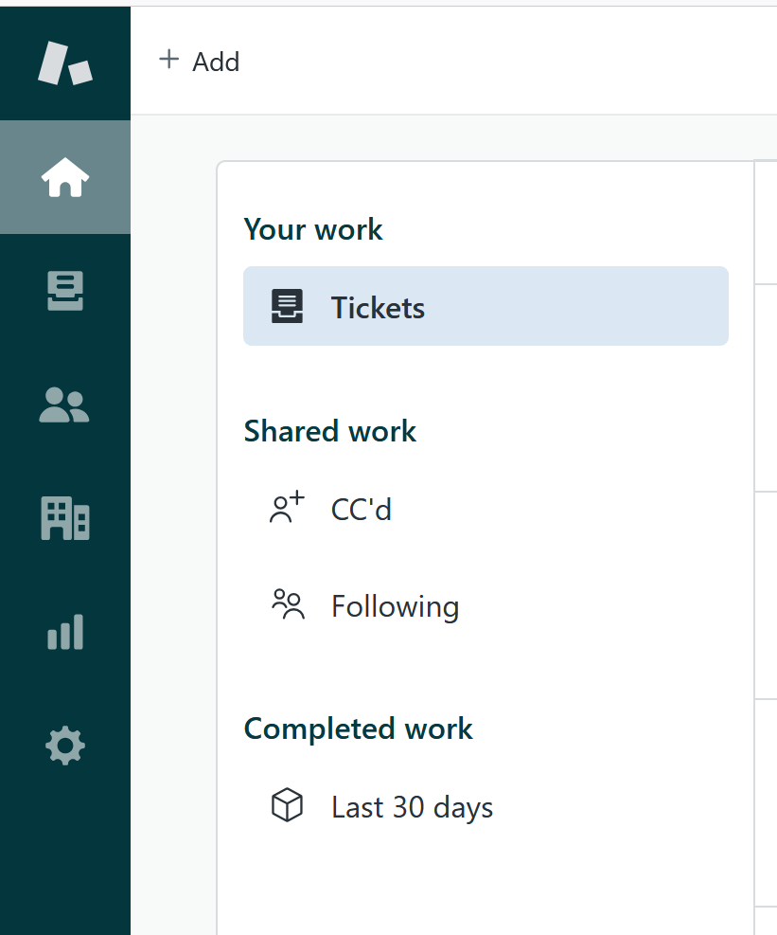
RI#1: Zendesk – Focal point for all support requests
Customer success: Monthly Support Report - August 2025
🛠️ RI#1 Zendesk – Establishing a Unified Entry Point for Support
As Owkin continues to scale, it's essential to align support infrastructure with organizational growth. In August , we plan to finalize the consolidation of all incoming support requests into Zendesk as the primary entry point, reducing fragmentation across Slack, email, and ad-hoc channels.
This effort aims to create a single source of truth for all support interactions, enabling faster response times, clearer ownership, and more consistent reporting.
✅ Key Improvements Implemented:
🔧 Ticket Visibility Enhancement
• Created a dedicated view for tickets tagged with k-signup-request
• Resolved visibility gaps for API-submitted onboarding tickets
🔧 Welcome Message Automation
• Implemented branded welcome messages for Abstra and Owkin K
• Personalized replies direct Owkin K users to the Help Center
• Messages are instant but do not impact FRT SLA, preserving reporting integrity
🌟 Why This Matters
These changes significantly improve first-touch user experience, reduce confusion, and foster a sense of proactive and structured support, especially as ticket volumes increase.
This foundation sets the stage for future expansion and ensures Zendesk can scale with Owkin's evolving support needs.

Slide 19
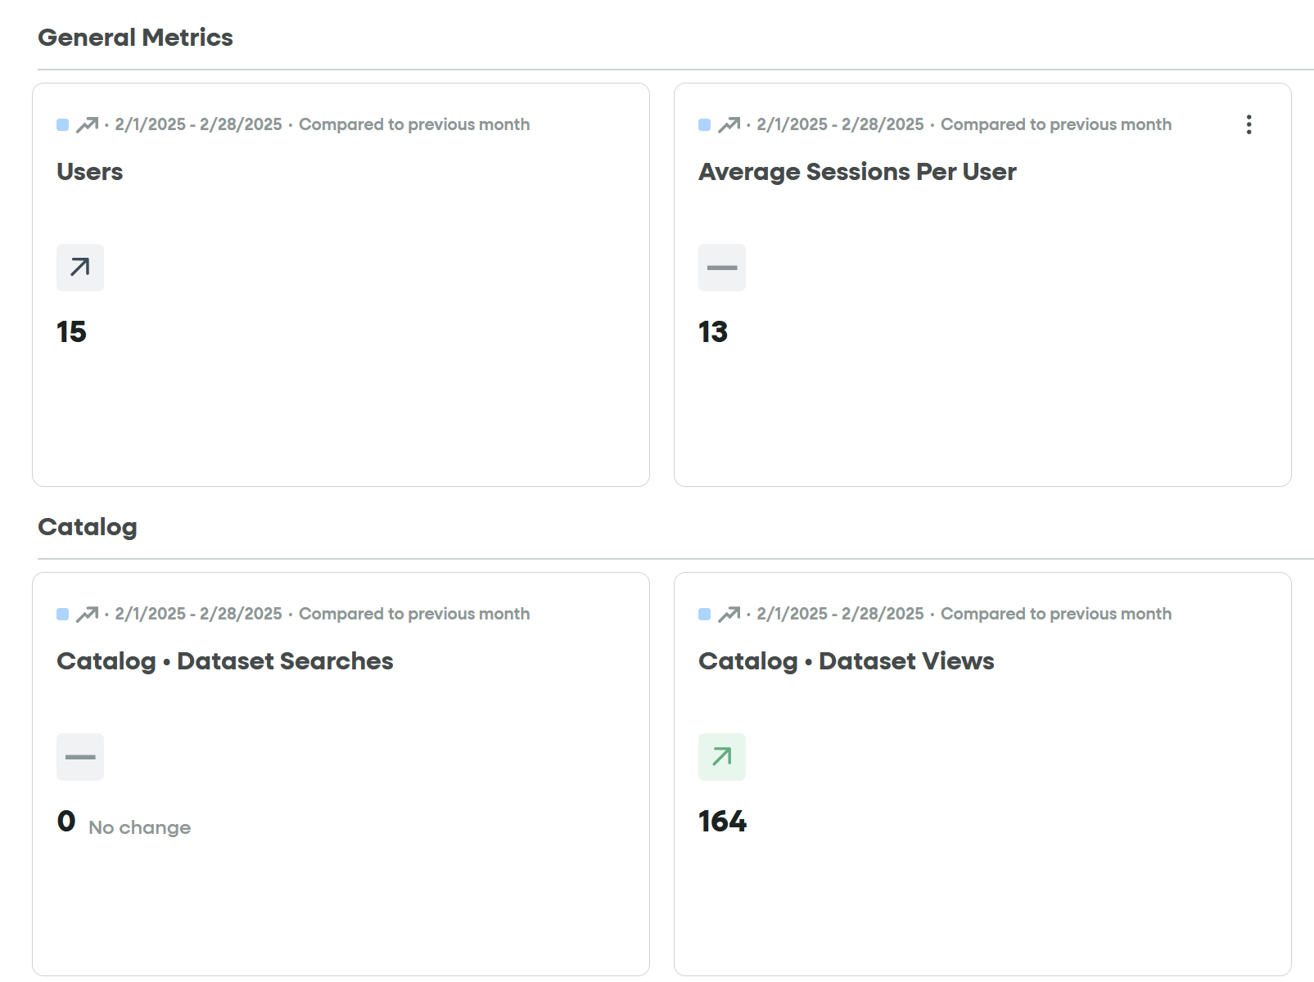
RI#2 PostHog Analytics Rollout for Support Operations
Customer success: Monthly Support Report - August 2025
🚀 RI#2 – PostHog Analytics Rollout for Support Operations
Objective
Implement a unified analytics system via PostHog to provide real-time visibility on triage efficiency, SLA adherence, and user interaction patterns across K-Navigator tickets.
Why it matters
Manual tracking of support metrics limits our ability to proactively detect SLA breaches and onboarding friction points. By migrating core KPIs into PostHog dashboards, we gain instant access to actionable data without relying on fragmented tools like FullStory and SurveySparrow.
→ PostHog dashboards will centralize key KPIs (First Response Time trends, Ticket Conversion Funnels, Rage Clicks).
→ Session analytics and targeted feedback widgets will enable smarter follow-ups post-resolution.
→ Automation of SLA breach alerts through dashboard views will support quicker escalations.
Expected Impact
→ Enhanced SLA tracking with live FRT and resolution time monitoring.
→ Consolidated reporting and analytics workflows, reducing tool switching.
→ Better identification of onboarding blockers through UX interaction data.
→ Improved team alignment via shared dashboard visibility (Product, Support, Engineering).

Slide 20
Agenda
1
Part I: Abstra support key metrics
2
Part II: Achievements & roadmap
3
Part III: Roadmap items
deep dive
4
Part IV: Product Insights
5
Part V: Next steps

Slide 21
Next steps for Customer Success
Customer success: Monthly Support Report - August 2025
Deliver excellent customer service
→ Maintain <30 min first response time for all requests with better triage priorities.
→ Resolve promptly signup access requests and streamline VPN clarifications for external Abstra users.
→ Continue direct Slack/Zendesk support for real-time troubleshooting and user onboarding assistance.
Strengthen Zendesk Operations
→ Finalize and distribute Internal Support Playbook to standardize L1/L2 handling and triage flows.
→ Track impact of auto-closure logic and escalations, ensuring queue reduction and faster agent onboarding.
Please do not hesitate to reach out to me for any questions.
Operationalize Insights to Improve Onboarding Experience
→ Finalize PostHog dashboards for proactive SLA monitoring and UX friction tracking (replacing FullStory & SurveySparrow).
→ Use PostHog funnels and Rage Click metrics to detect workflow blockers in onboarding processes.
→ Collaborate with Product to align dashboard insights with UX adjustments and form logic improvements.
→ Implement targeted feedback collection post-resolution to continuously refine user onboarding experience.

Slide 22
Agenda
1
Part I: Abstra support key metrics
2
Part II: Achievements & roadmap
3
Part III: Roadmap items
deep dive
4
Part IV: Product Insights
5
Part V: Next steps

Slide 23
Thank you!

